Slide 1
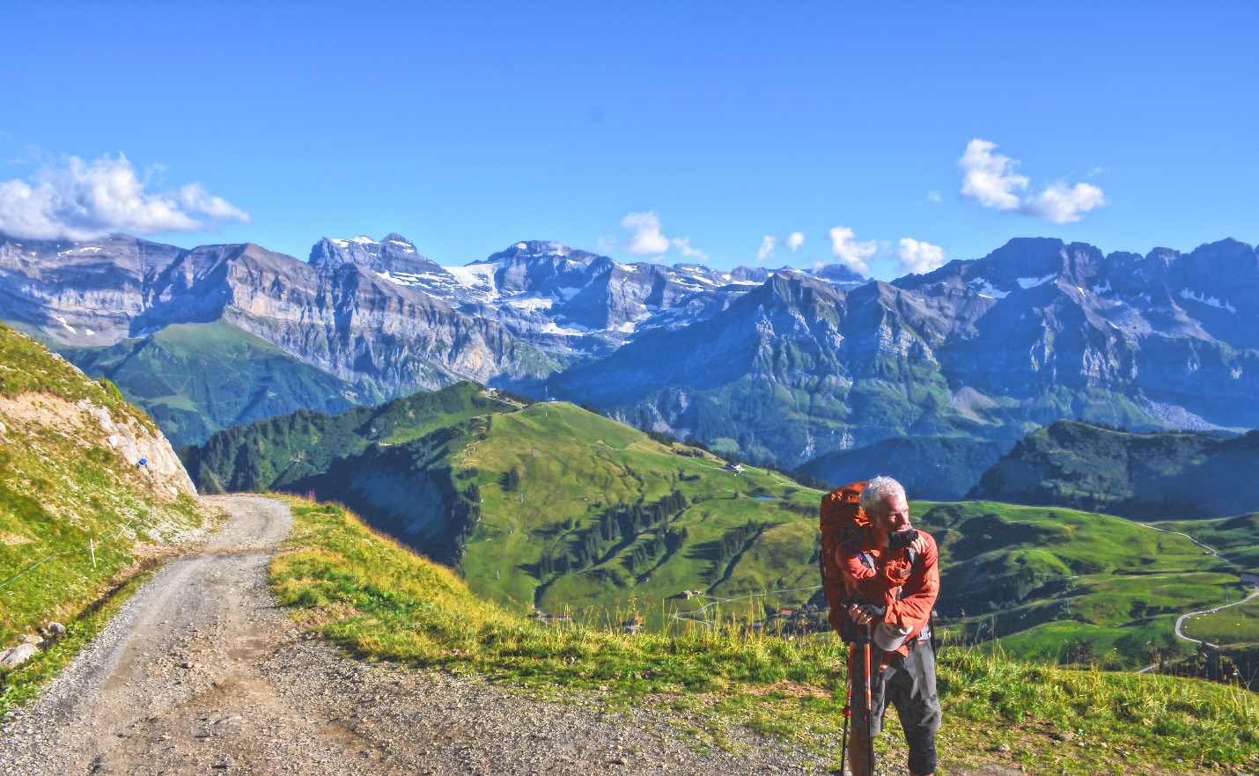
Take A Hike
The scenic route to life: A fast way to plan, implement and record your hiking adventures

Slide 2
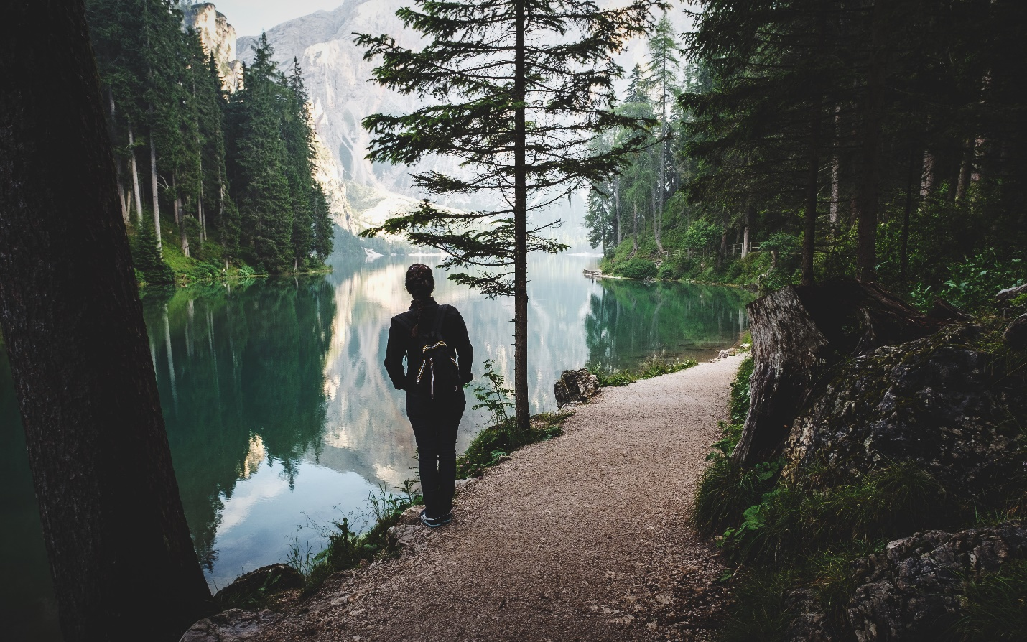
Why we chose hiking?
There is no better way to enjoy nature than to hike trails. To full appreciate your surroundings, you must take it in slowly. The sights, the sounds and the smells of nature cannot be absorbed in an air-conditioned car traveling 80 miles an hour. You must fully engage your senses to your surroundings to get the peace and tranquility that only a hike can give. To decompress from life, you must slow down and spend time in nature. And we can make it easier with our “Take A Hike” app to help you plan and record your experiences. Walk through the interesting paths of life. See the sights that are not available on any road. And take a hike!

Slide 3
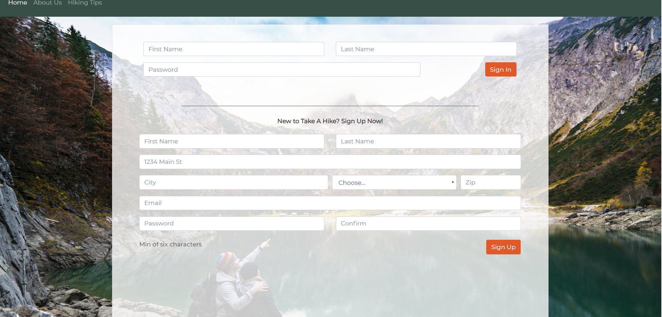
Sign in first time with name, address, email and password. This makes a cookie for reusing program.

Slide 4
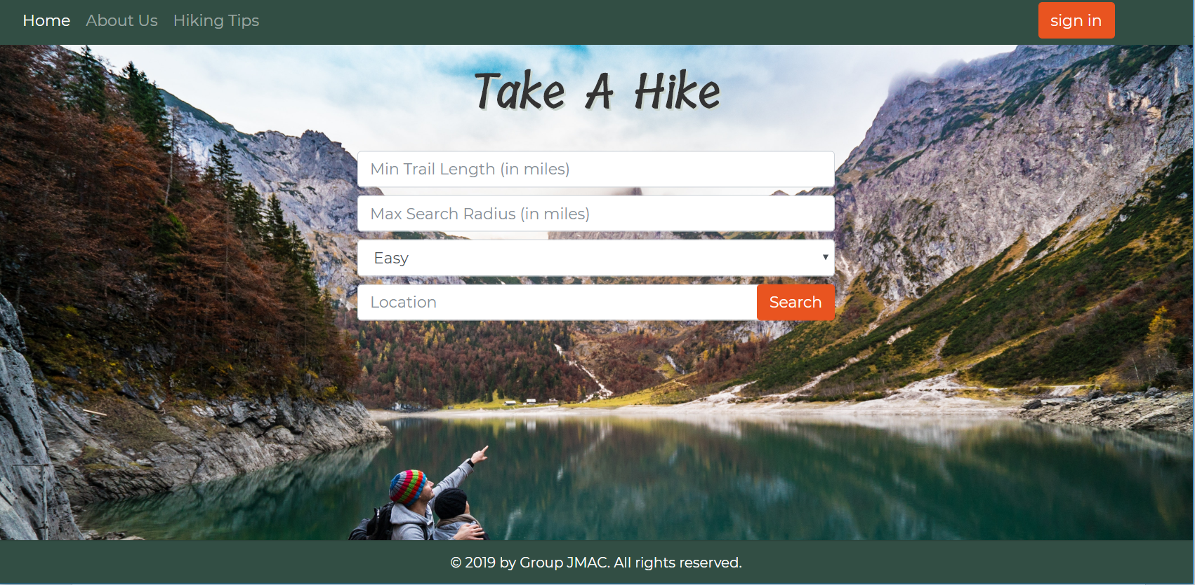
Second page with sign in and parameters for the hike

Slide 5
Hiking tips
Preparing for the hike base on group going, duration, time of year and weather conditions.
Saved hikes with locations name, date time of day, weather conditions and distance. Important notes about the hike: rate hike difficulty. How you felt after hike. Was it too difficult, fun or not challenging enough? What time of the year did you go? Was it too cold, too hot, rainy, snowy, damp? When is the best time of year to hike this location? When is not the best time?

Slide 6
Project parameters needed for project
https://www.hikingproject.com/
Zipcode npm
Passport.js
Use cookies for sign in
Handlebars
https://maps.googleapis.com/maps/api/geocode/json?latlng google maps supply latitude and longitude coordinates.

Slide 7
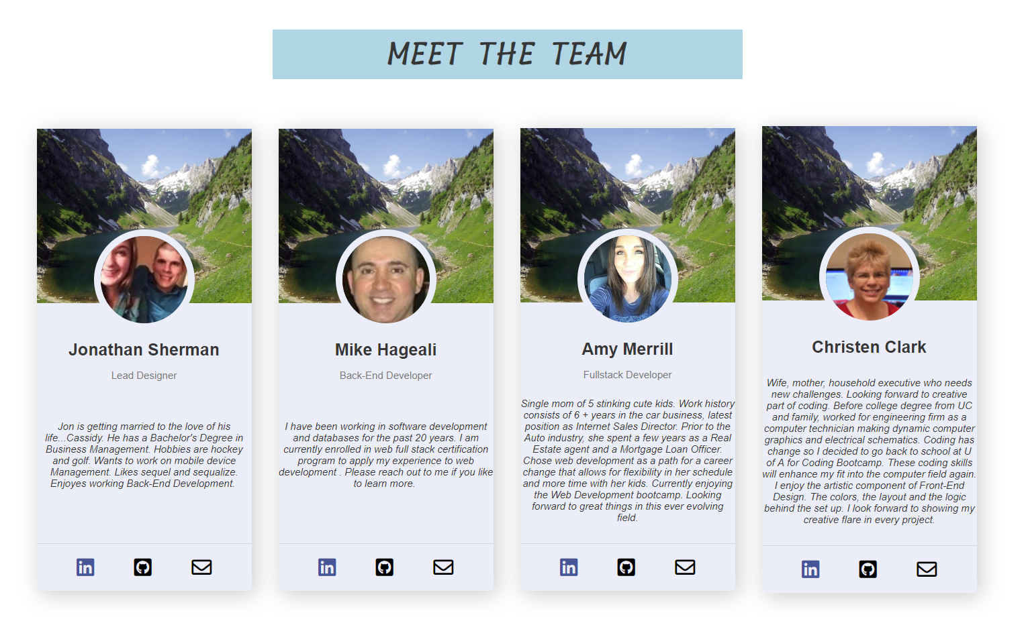

Slide 8
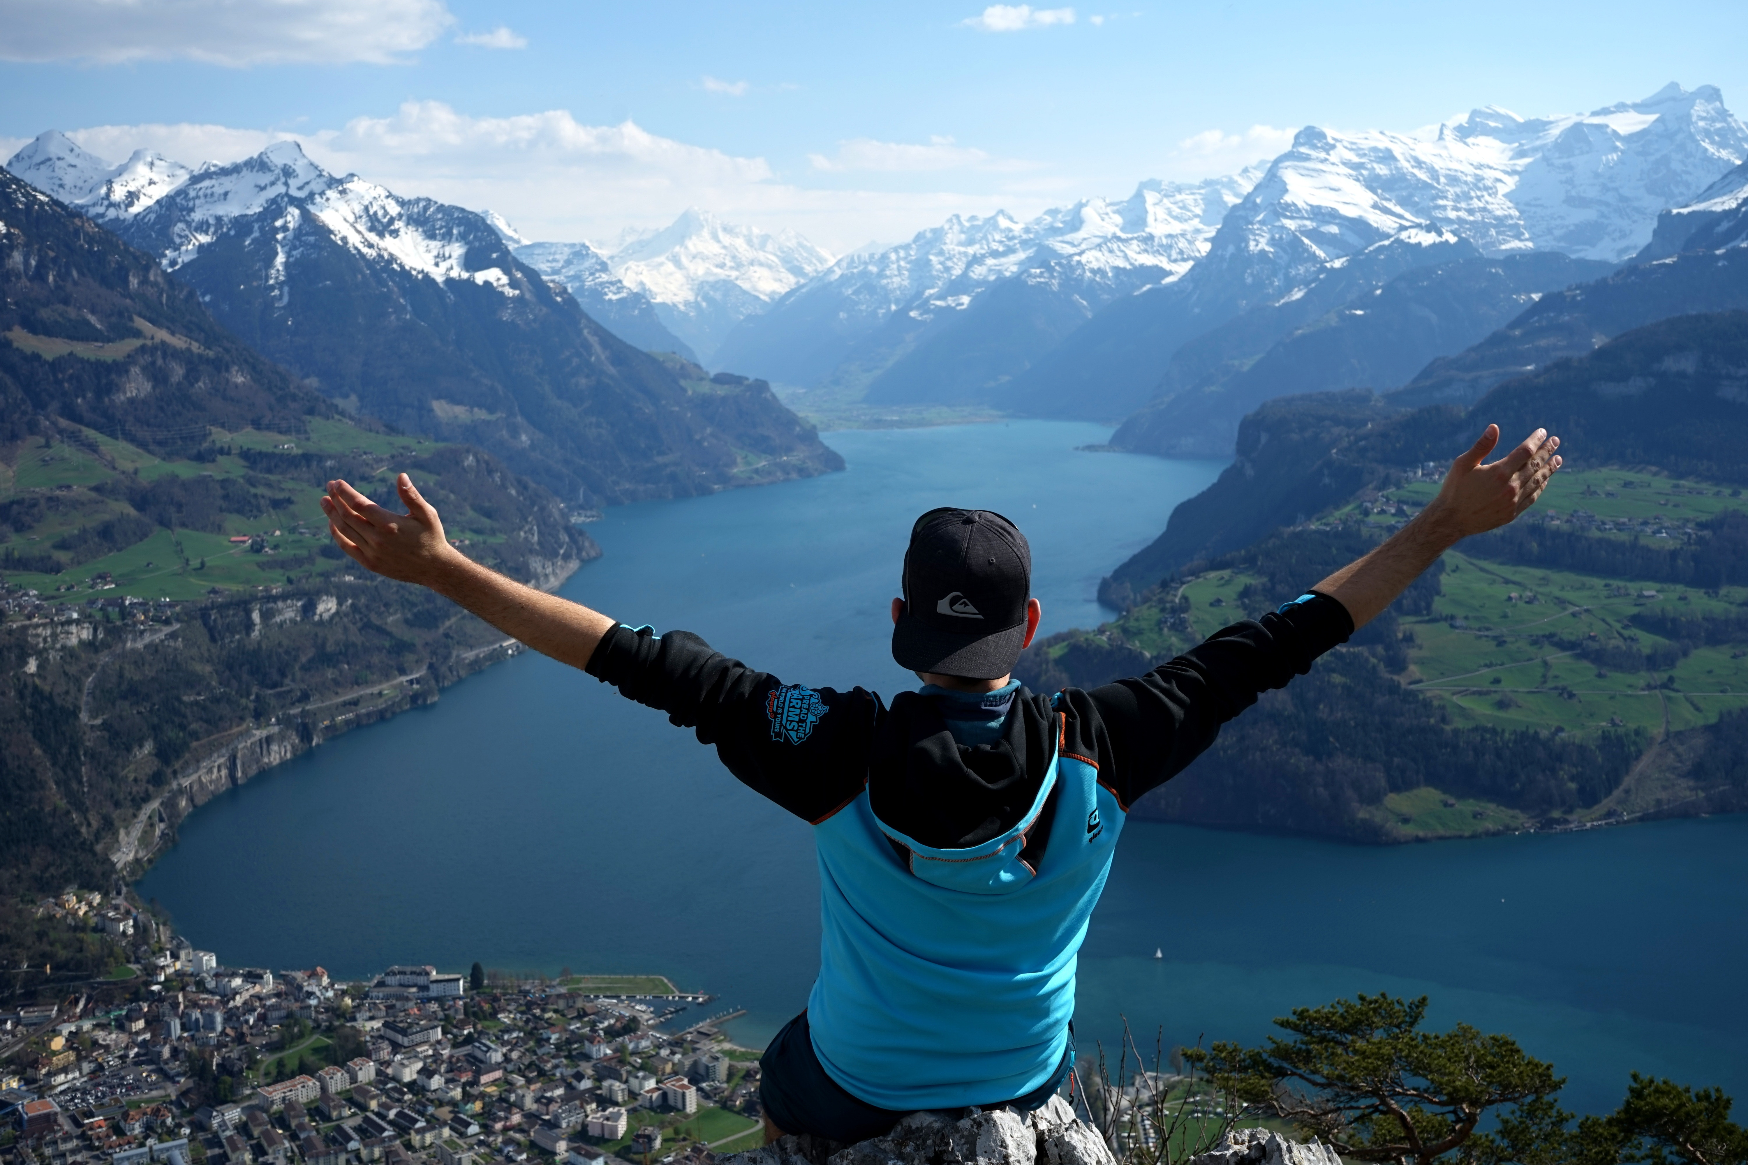
Thank You

